Slide 1

MENTAL
HEALTH
Team Members:
Tan Jin Chun
Tan Wei Chun
Low Chin Boon

Slide 2
What is Mental Illness?
Mission
A common disease that affects one’s :
Emotions
Thinking
Behaviour
Experience extreme mood swings
Think negatively
Unable to think clearly
Changes in appetites
Feeling fatigue
Lose focus easily
Insomnia

Slide 3
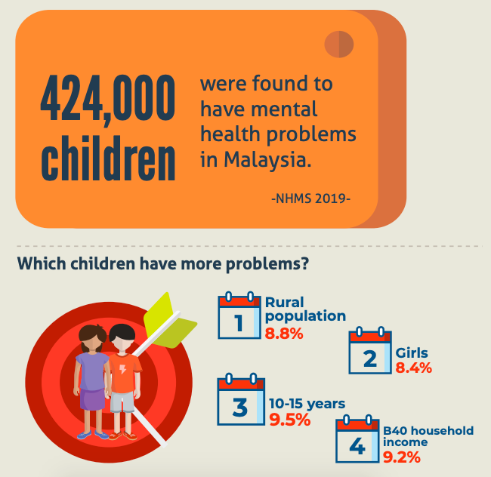
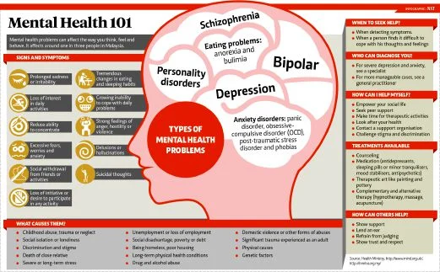
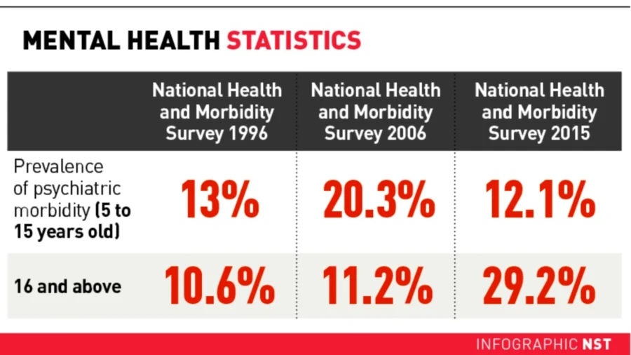
How Common?
In Malaysia, mental illness is the second biggest health problem after heart disease.
According to National Health and Morbidity Survey in 2020, every 3 in 10 adults aged 16 years old and above suffer some form of health mental issues

Slide 4
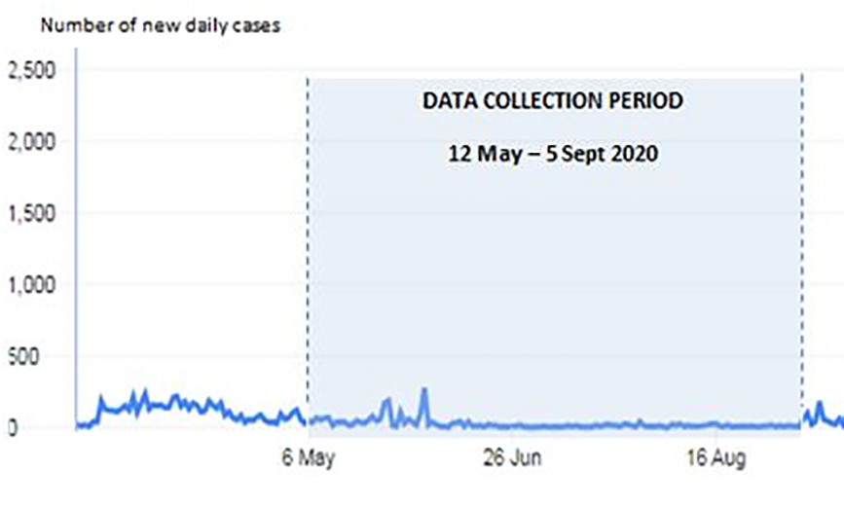
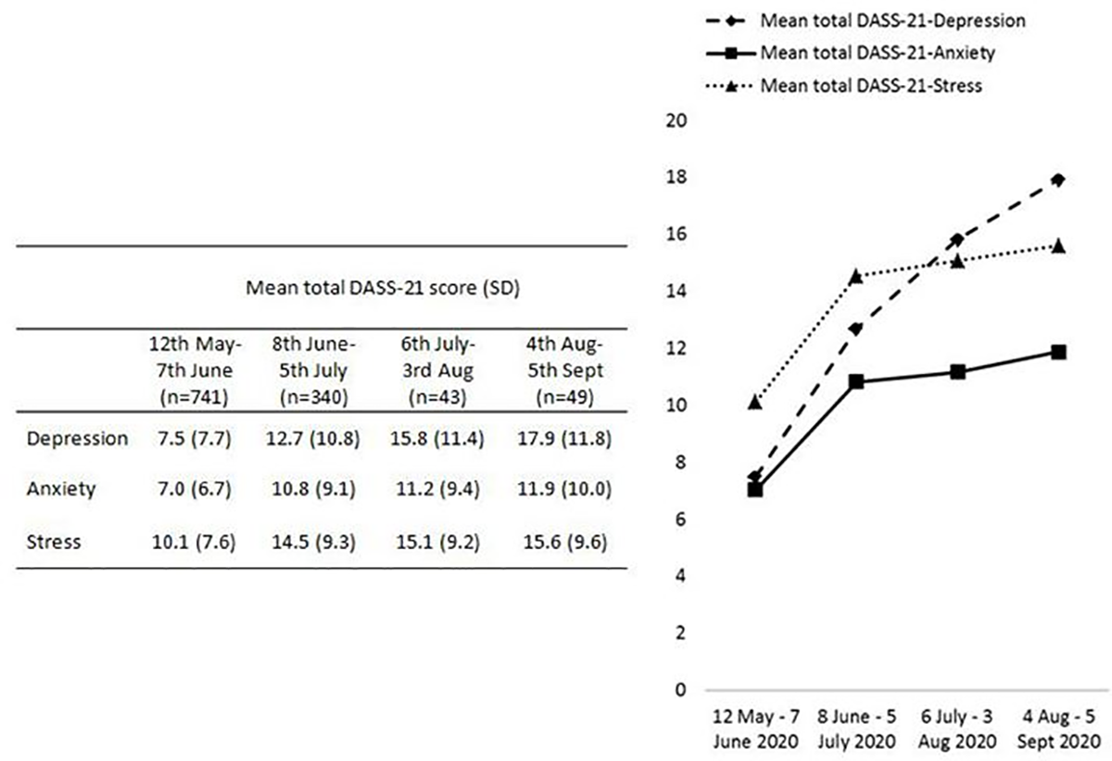
Report: Effects of Covid 19 on mental health:
Source: https://doi.org/10.1371/journal/pone.0248916
Covid 19 does not only affect the physical health, but also MENTAL HEALTH !!!

Slide 5
REASONS OF MENTAL ILLNESS
Substance Abusement
Drug
Alcohol
Stress and Trauma
Working and studying
Childhood trauma
Environmental
Living in poverty
Family abusement
Unemployment
Other stressful events:
Losing a loved one
Physical ill health
Accidents

Slide 6

SOLUTIONS
Seek professional help from consultants (E.g. Befrienders)
Let them share as much as they want to
Keep yourself active (Exercise regularly)
Eat well, drink sensibly
Take a break

Slide 7
Benefits of Psychic
Tell us how you feel !!!
Users can write and share their experience or sorrow as much as they want anytime
Provide life-saving information in emergencies (E.g. Befrienders Hotline)
Long Term Professional
Consultancy
Offer advice and help from professional consultants
Keep track of the progress of user’s mental health
Help user to set and achieve goals
Evaluate and Recommend
Evaluate the level of stress, anxiety and depression based on users’ sharing using machine learning
Provide appropriate health care plans based on the evaluated results
Knowledge
Provides information on different types and symptoms of the mental health problems

Slide 8

DEMO
TIME!!!

Slide 9
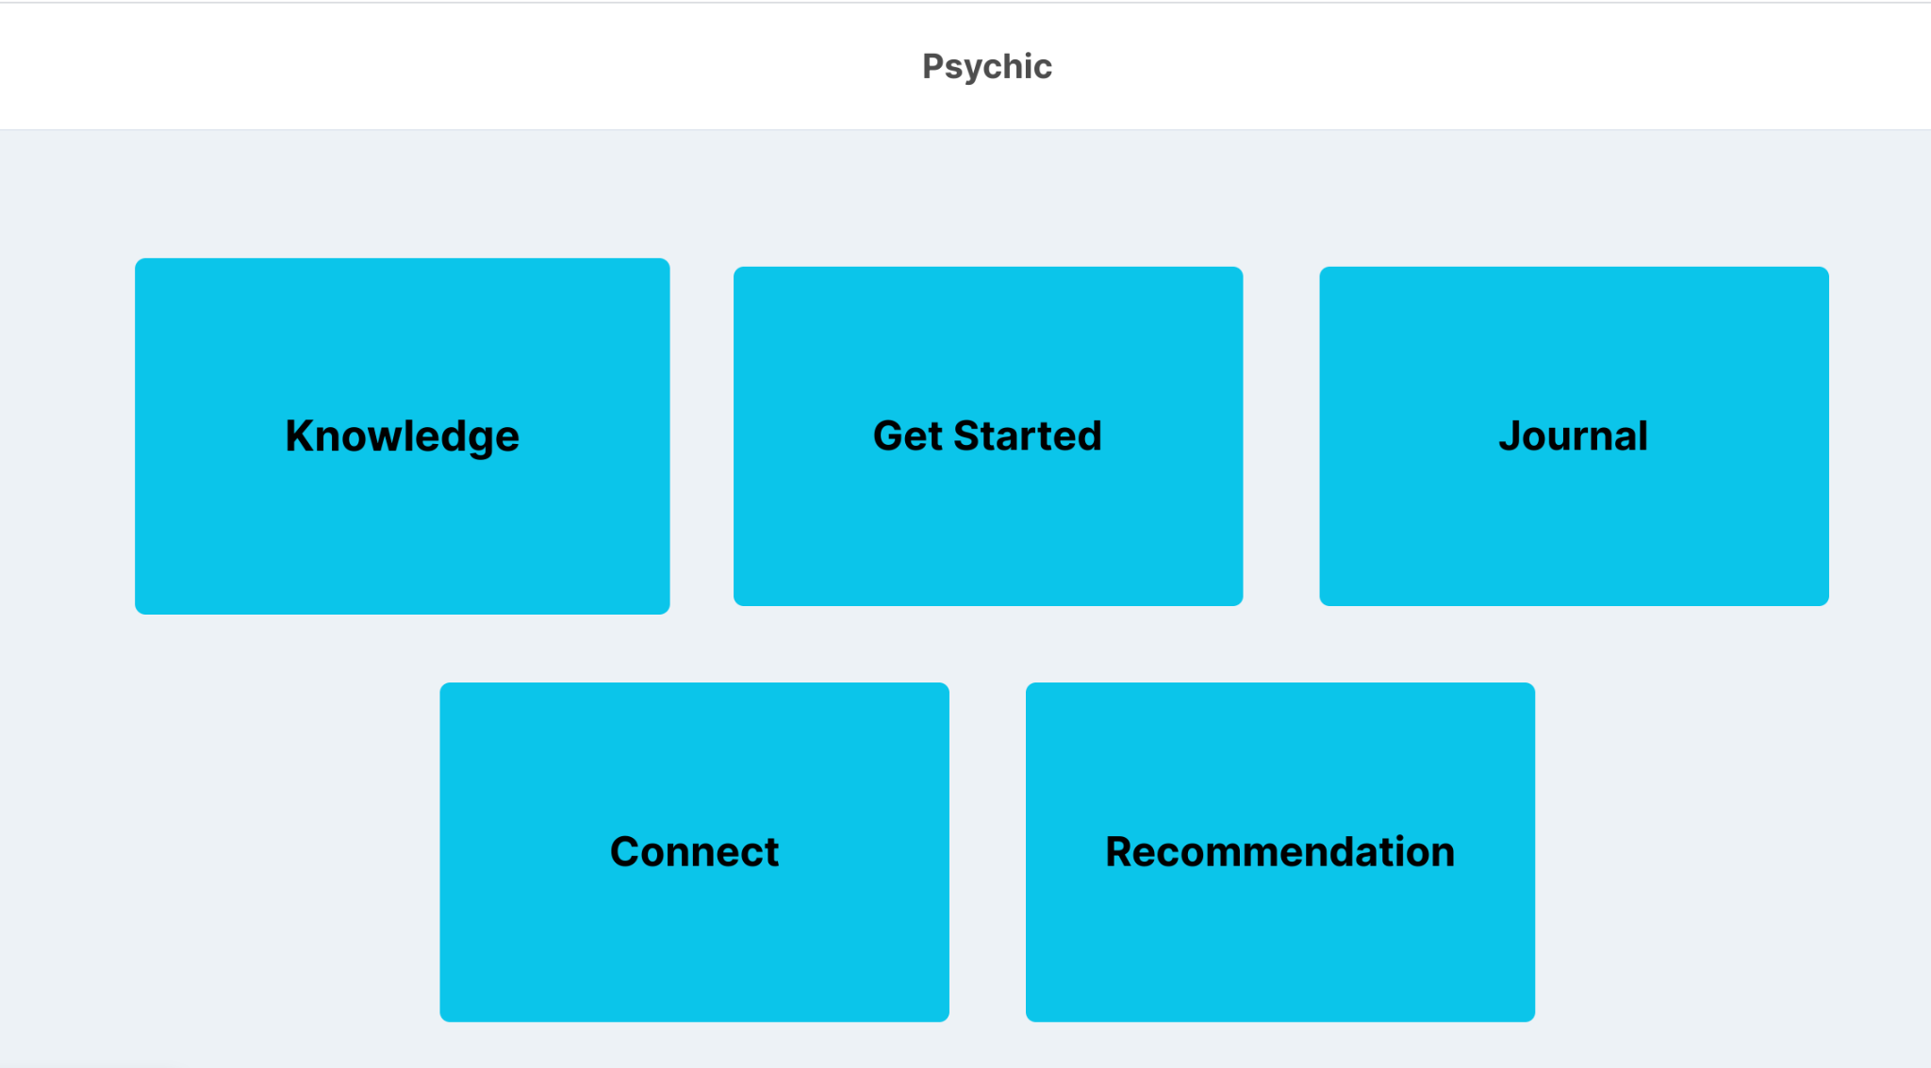
Main Page

Slide 10
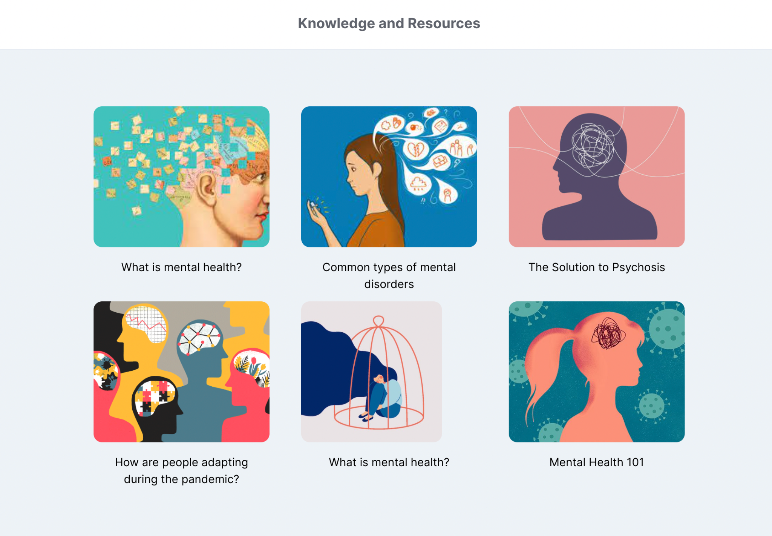

Slide 11
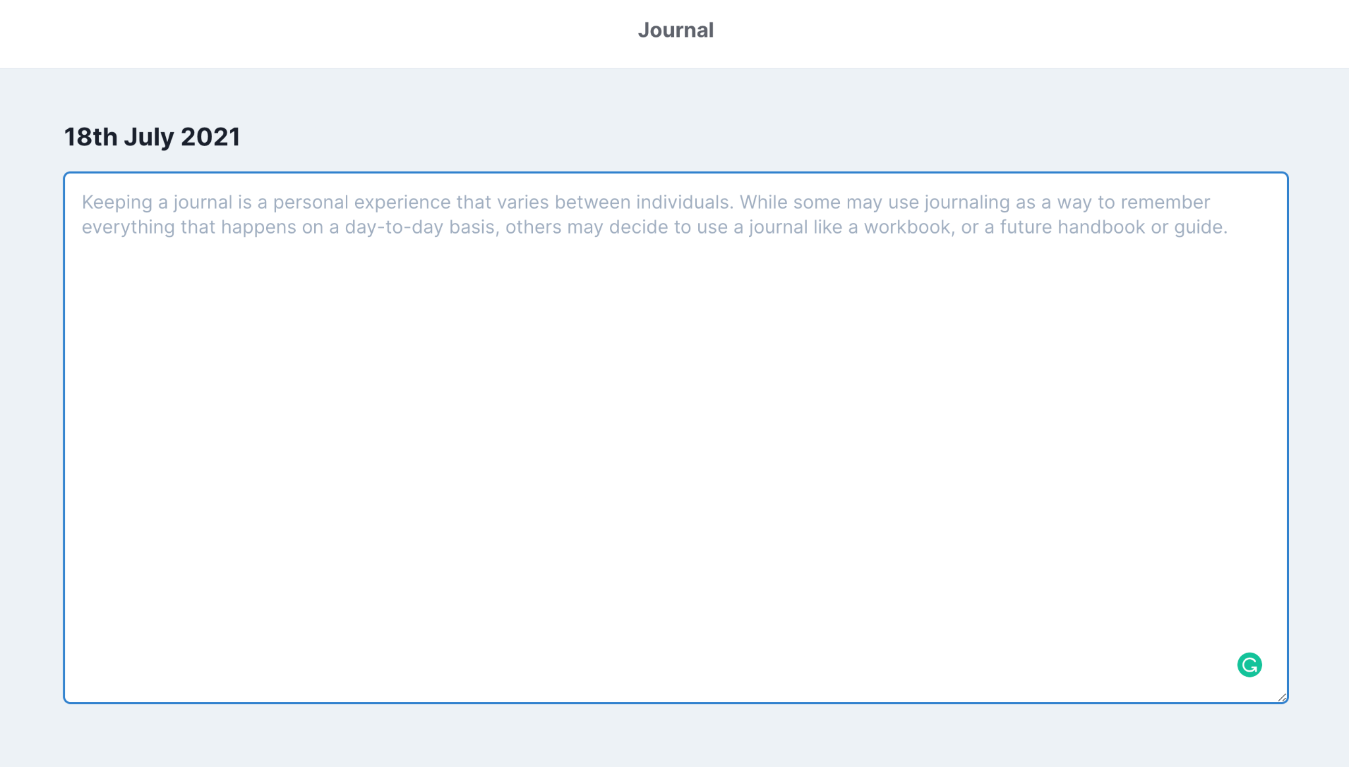
Journal

Slide 12
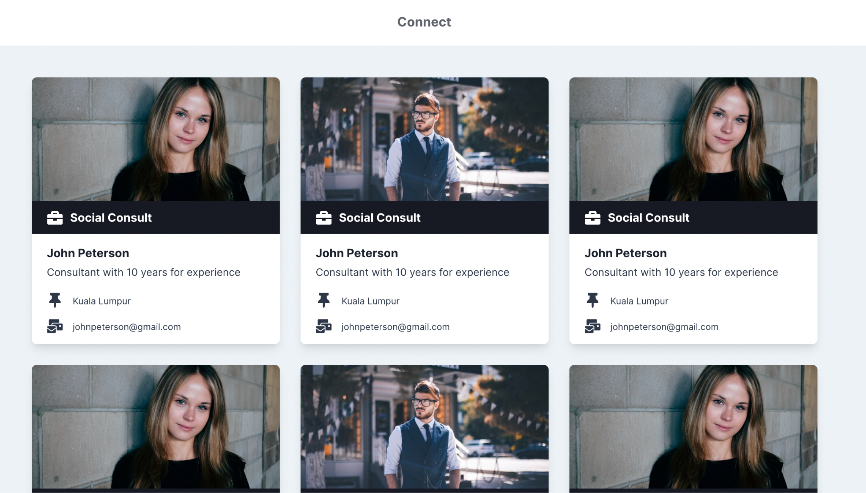
Connect with A Consultant

Slide 13
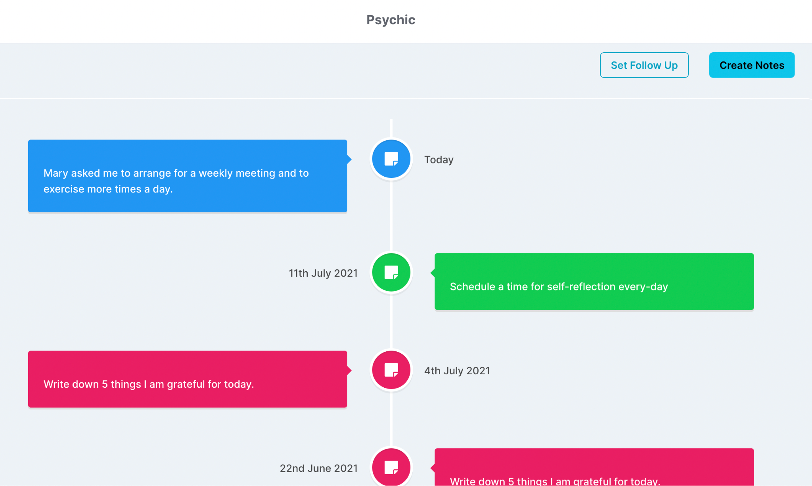
Notes on Consultation

Slide 14

BEAT your anxiety with therapy!
Don’t be ashamed to tell us your story!

Slide 15
Table of contents
01
Our Center
02
Key Numbers
03
Patient Care
04
Results
You can describe the topic of the section here
You can describe the topic of the section here
You can describe the topic of the section here
You can describe the topic of the section here

Slide 16
Introduction
Here you can give a brief description of the topic you want to talk about. For example, if you want to talk about Mercury, you can say that it’s the smallest planet in the entire Solar System

Slide 17

Our center
Venus has a beautiful name and is the second planet from the Sun. It’s hot and has an extremely poisonous atmosphere. It’s the second-brightest natural object in the night sky after the Moon

Slide 18

A picture always reinforces
the concept
Images reveal large amounts of data, so remember: use an image instead of a long text

Slide 19
Awesome words!

Slide 20

—Someone famous
“This is a quote. Words full of wisdom that someone important said and can make the reader get inspired”

Slide 21

A picture is worth
a thousand words

Slide 22

Key numbers
20,000
50,000
This is the number of patients we had last month
This is the number of total visitors we had last month
5,000
This is the number
of transplants performed

Slide 23
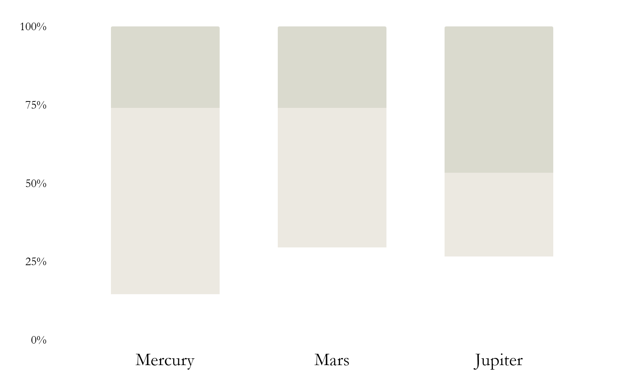
Our statistics
Mercury
Neptune is the farthest planet
Mars
Jupiter is a gas giant planet
Jupiter
Saturn is the ringed planet
Follow the link in the graph to modify its data and then paste the new one here. For more info, click here

Slide 24

A brief story
Mercury is the closest planet to the Sun and the smallest one in the Solar System—it’s only a bit larger than the Moon.
Venus is the second planet from the Sun
Earth is the planet where we live on
Neptune is very far away from Earth

Slide 25

Milestones reached
2020-2021
Venus has a beautiful name
Year
2022
2018-2019
It’s a gas giant and the biggest
2017-2018
2019-2020
Jupiter is the biggest planet
It’s a gas giant and the biggest

Slide 26
Our process
01
Venus
Mars
03
Venus has a beautiful name
Despite being red, Mars is cold
02
Saturn
Jupiter
04
It’s a gas giant and has rings
Jupiter is the biggest planet

Slide 27

02
Key Numbers
You can enter a subtitle here if you need it

Slide 28
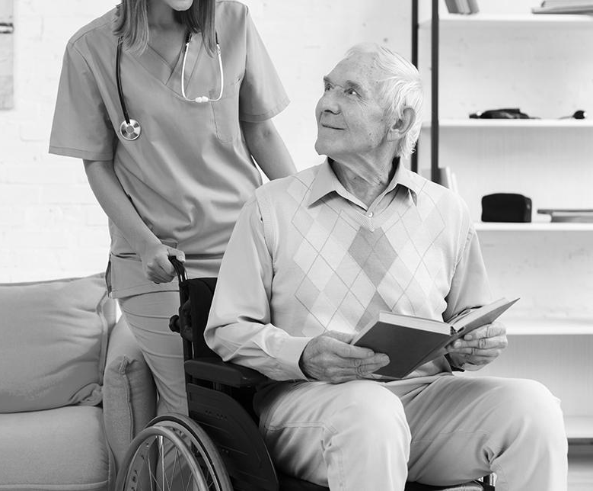
Patient care
Mercury is the closest planet to the Sun and the smallest one in the Solar System—it’s a bit larger than the Moon. The planet’s name has nothing to do with the liquid metal

Slide 29

Areas we cover
Mercury
Jupiter
Mercury is the closest planet to the Sun
It’s a gas giant and the biggest planet
Venus
Saturn
Venus is the second planet from the Sun
It is the ringed one. It’s a huge gas giant

Slide 30
Key accomplishments
Mars
Jupiter
Saturn
Despite being red, Mars is a very cold place
It’s a gas giant and the biggest planet
Yes, this is the ringed one. It’s a huge gas giant

Slide 31
This is a map
Venus
Venus is the second planet from the Sun
Jupiter
It’s a gas giant and the biggest planet
Mercury
Mercury is the closest planet to the Sun

Slide 32
4,498,300
Big numbers catch your audience’s attention

Slide 33
333,000,000
9h 55m 23s
386,000 km
earths is the Sun’s mass
is Jupiter’s rotation period
is the distance between Earth and the Moon

Slide 34
Patient satisfaction
60%
80%
30%
Mercury
Venus
Mars
Mercury is the smallest planet
Venus has a
beautiful name
Despite being red, Mars is a cold place

Slide 35
This is a table
 | Qty. | Booked | Sold | Refund | Percent
Mars | 2 | 12000 | 9800 | 500 | 80%
Venus | 3 | 6000 | 5000 | 450 | 50%
Jupiter | 4 | 2000 | 1500 | 300 | 70%
Saturn | 9 | 6000 | 5000 | 450 | 50%
Mercury is closest planet to the Sun and the smallest one in the Solar System

Slide 36
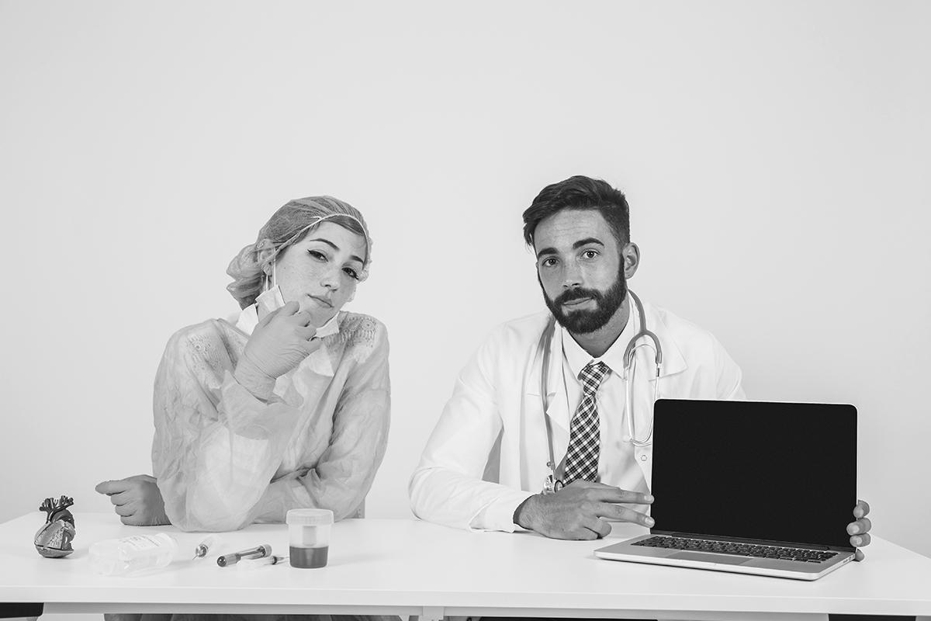
Our team
Ms. Gina
Mr. Rena
Mercury is the closest planet to the Sun and the smallest one
Venus has a beautiful name and is the second planet from the Sun

Slide 37
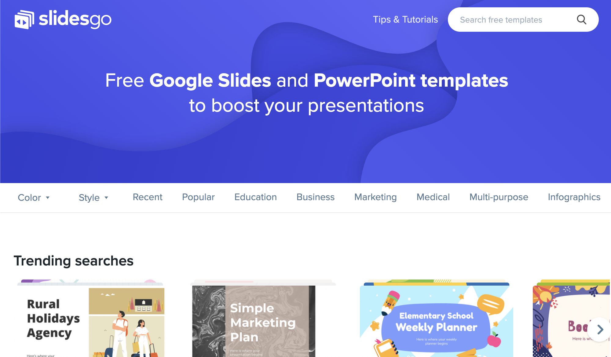
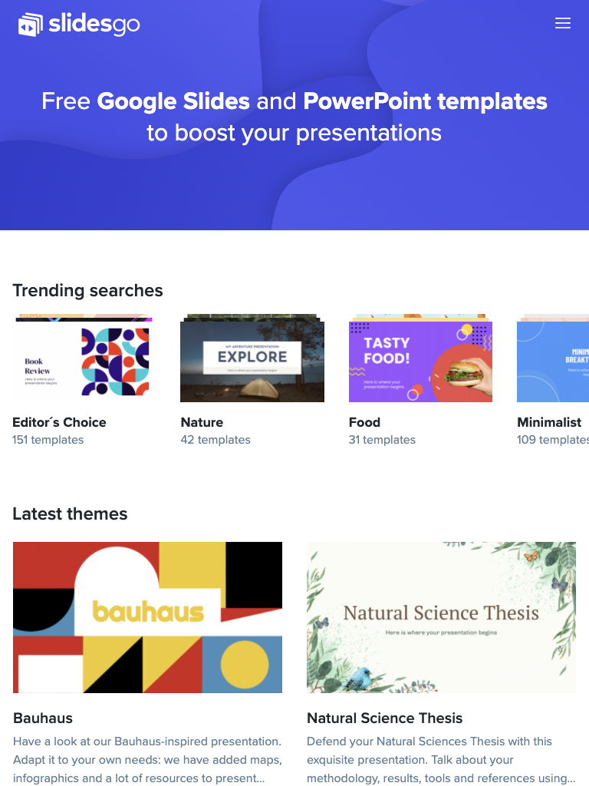
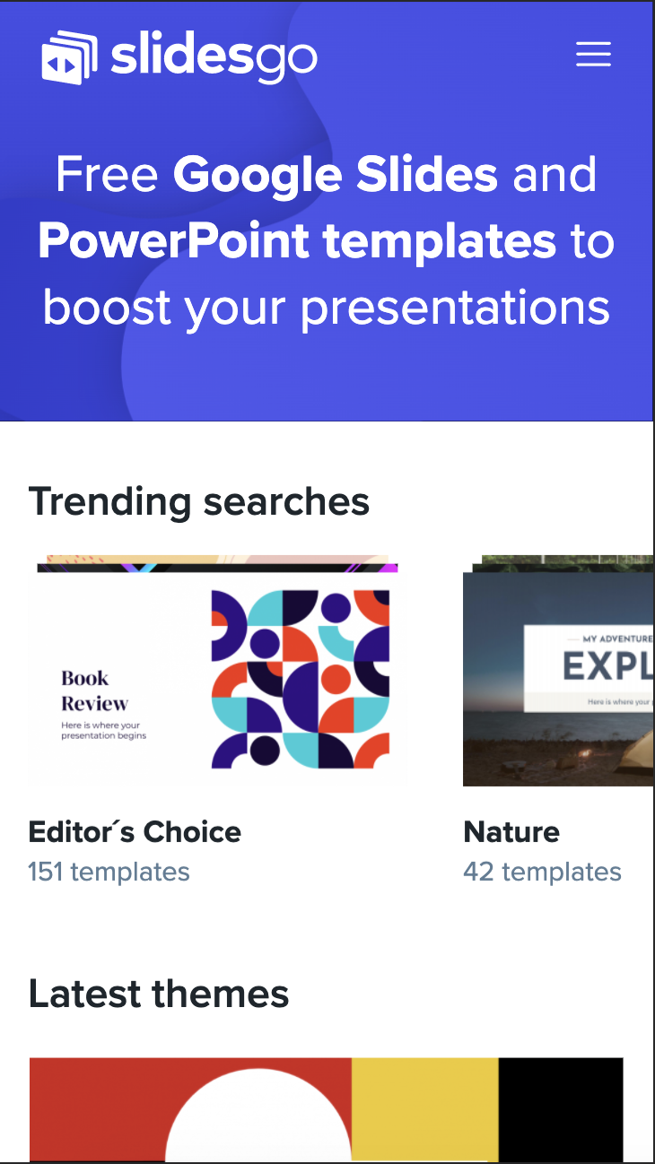
Mockups
You can replace the image on the screen with your own work. Right-click on it and then choose "Replace image" so you can add yours

Slide 38
Thanks
Do you have any questions?
addyouremail@freepik.com | +91 620 421 838 | yourcompany.com
Please keep this slide for attribution

Slide 39
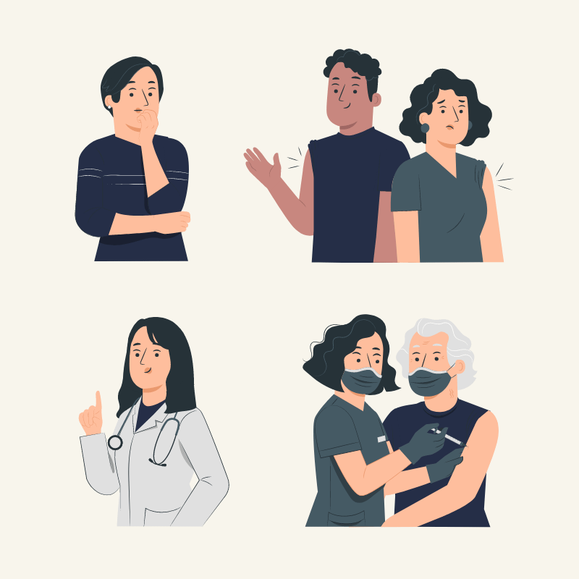
Alternative resources
Here’s an assortment of alternatives resources within the same style of this template. Find more illustrations like these on Storyset

